Slide 1
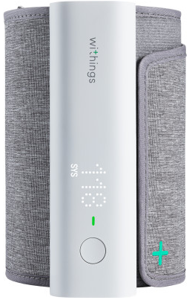
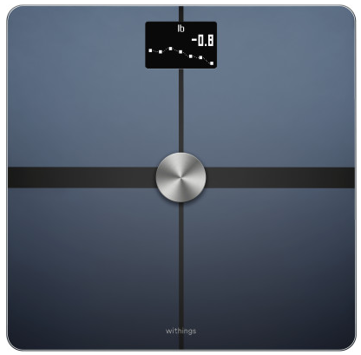
Remote Patient Monitoring Program & Get Your Health Record

Slide 2
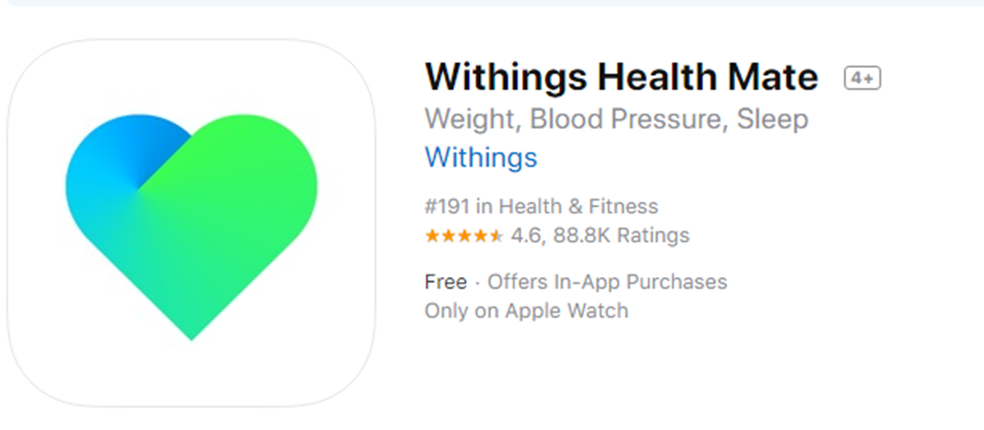
Download WiThings Health Mate App

Slide 3
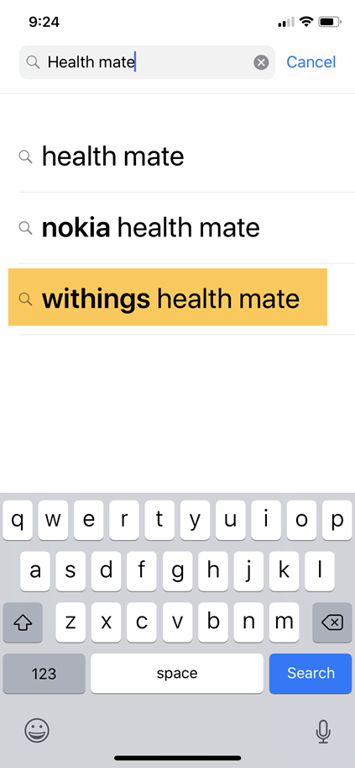
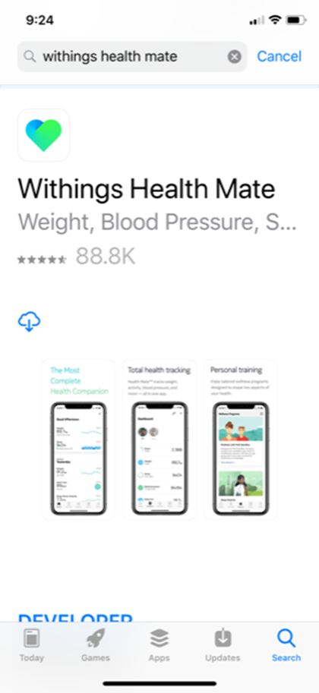
Search and Download Health Mate App

Slide 4
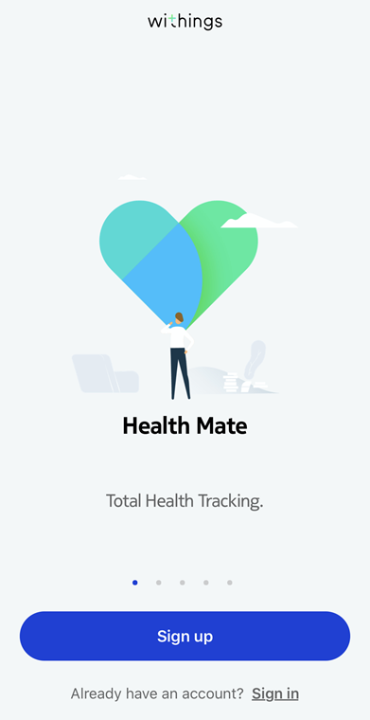
Sign Up

Slide 5
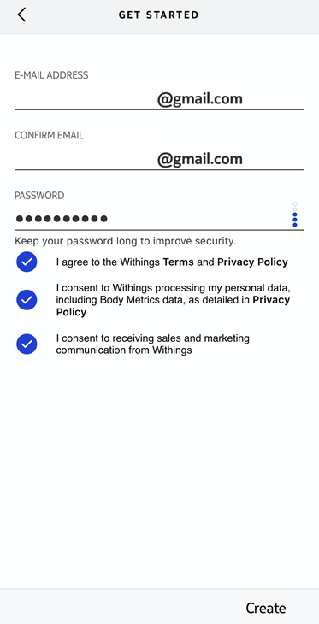
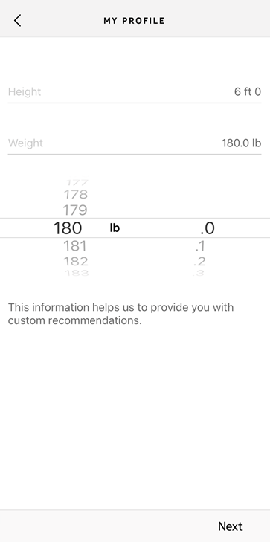
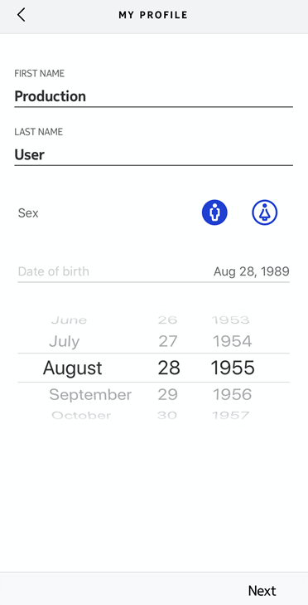
Create Account

Slide 6
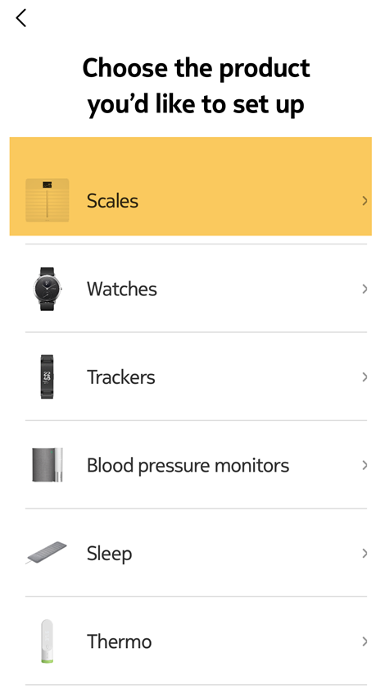
Body+ Body Scale Setup

Slide 7
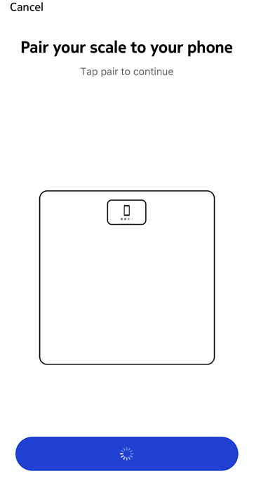
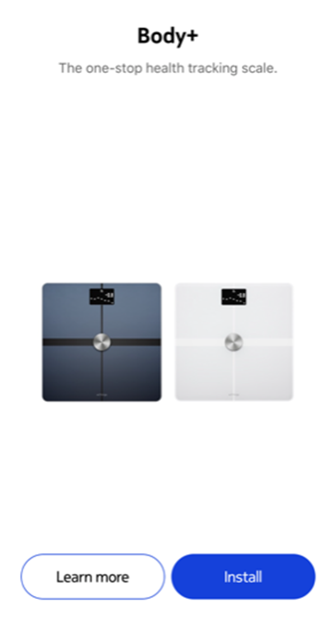
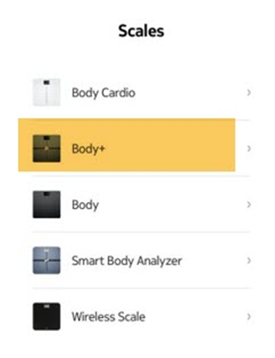
Body + Scale

Slide 8
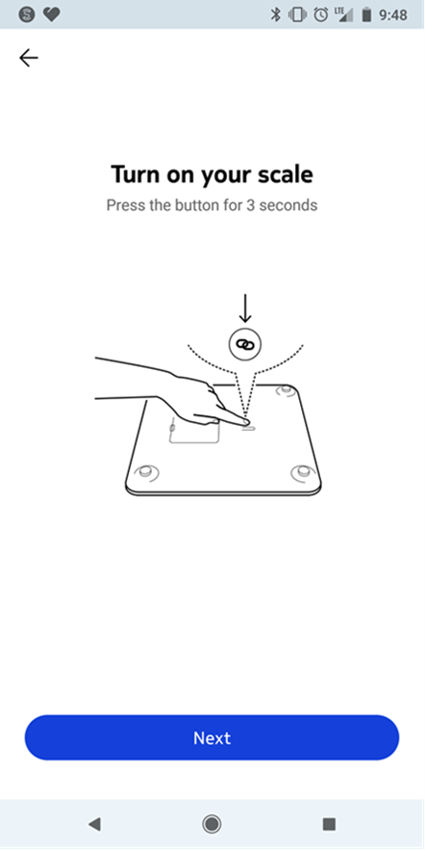
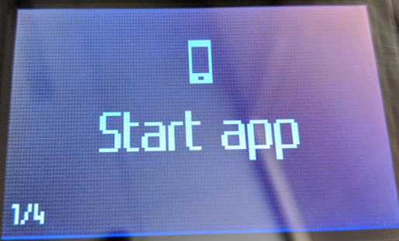
Body + Scale
When the scale displays “Start App” click the “Next” button on your app to start the sync process.

Slide 9
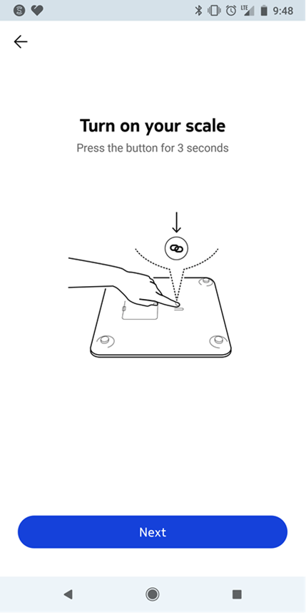
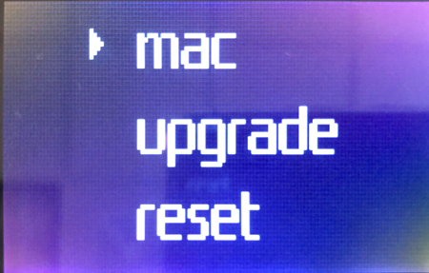
Installing Device Error
If you receive this message on your scale, you have pressed the button for too long. Please go back a step to try again.

Slide 10
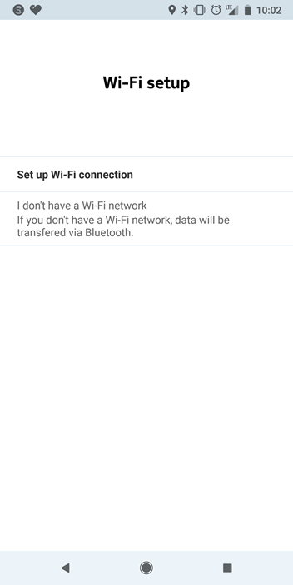
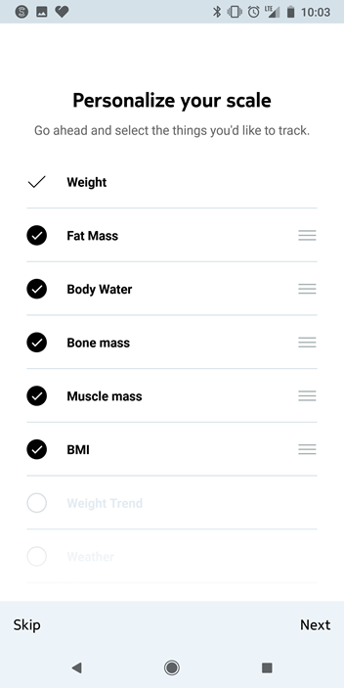
Setup
Connect via Bluetooth
Personalize your measurements

Slide 11
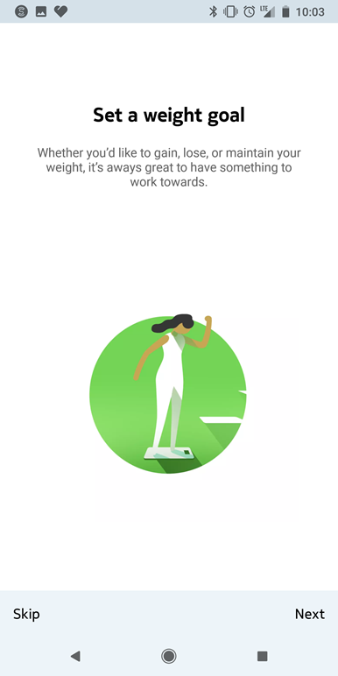
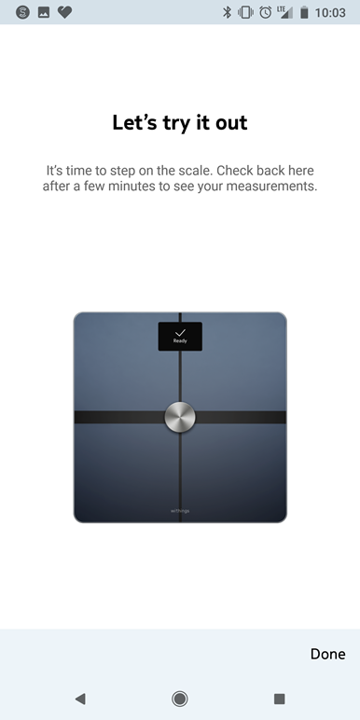
Setup
Set a goal
Get started!

Slide 12
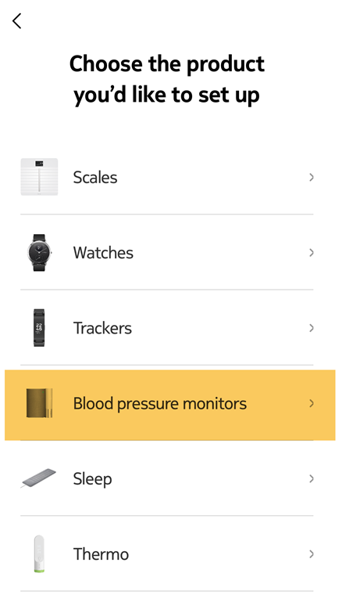
BPM Connect

Slide 13
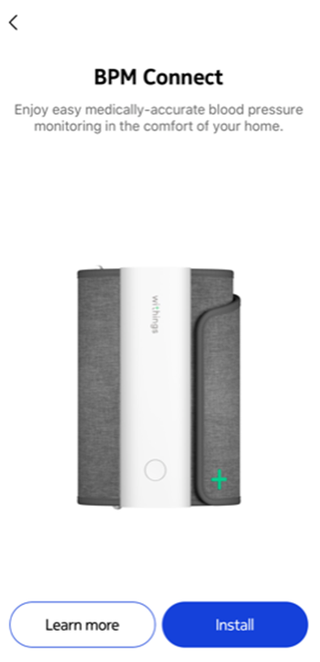
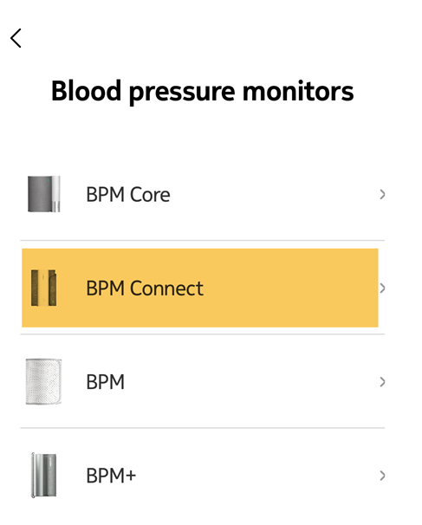
BPM Connect

Slide 14
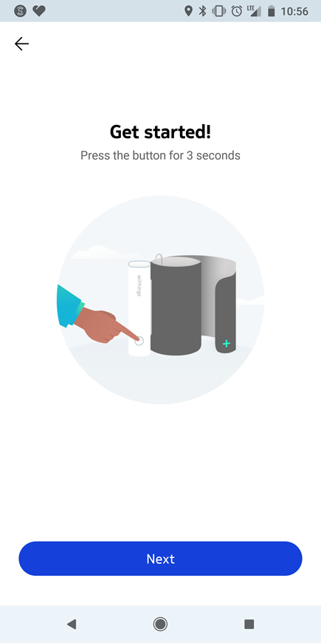
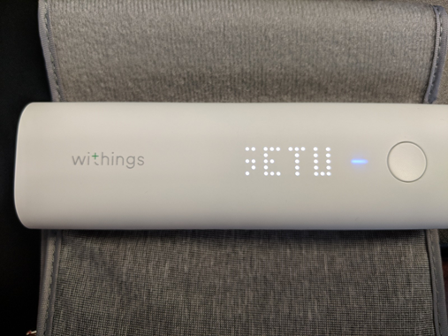
BPM Connect
When the “Setup” message displays across the Blood Pressure Monitor, click “Next” on your app to start the sync process.

Slide 15
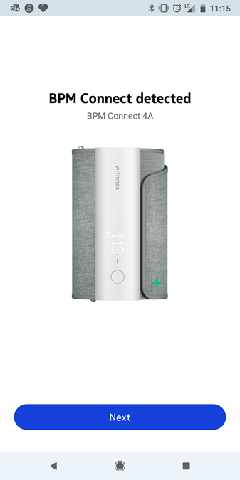
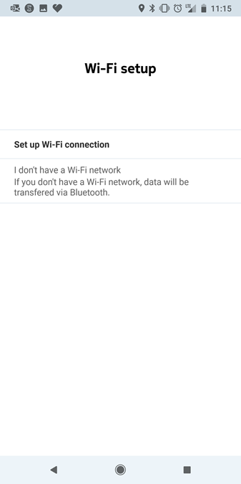
BPM Connect
Connection complete
Connect via Bluetooth

Slide 16
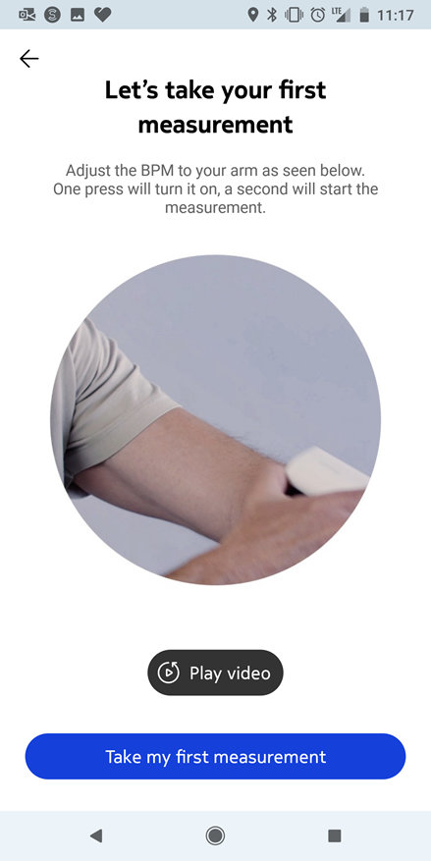
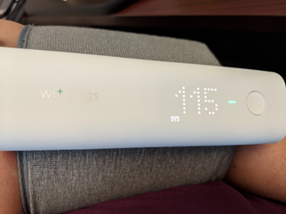
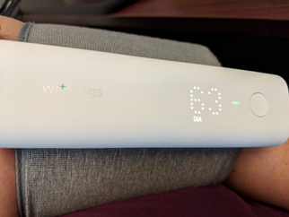
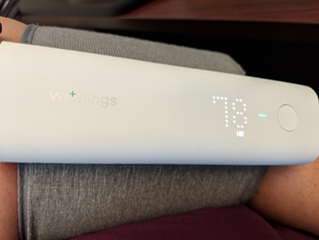
BPM Connect
Systolic
Diastolic
Heart Rate
To switch users: After reading is complete, hold button down till next name displays. Then tap button once to set.

Slide 17
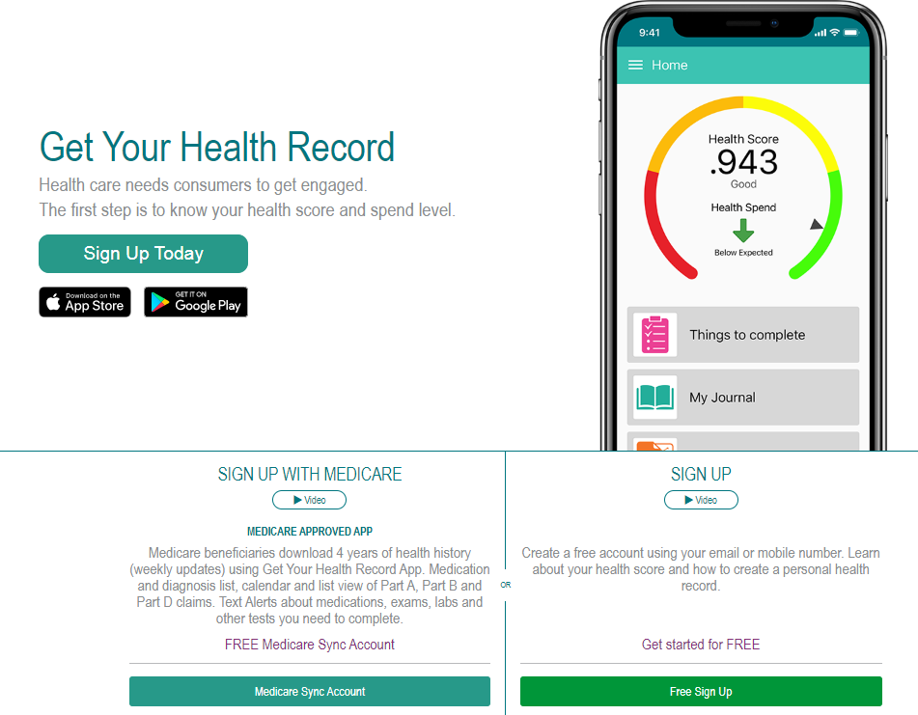
Get Your Health Record

Slide 18
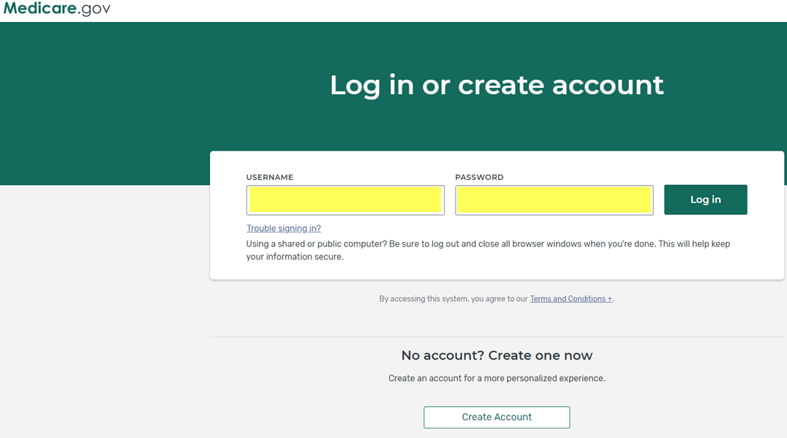
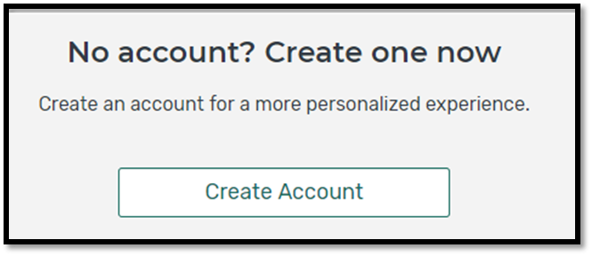
Get Your Health Record
Don’t have an account? Click Create Account

Slide 19
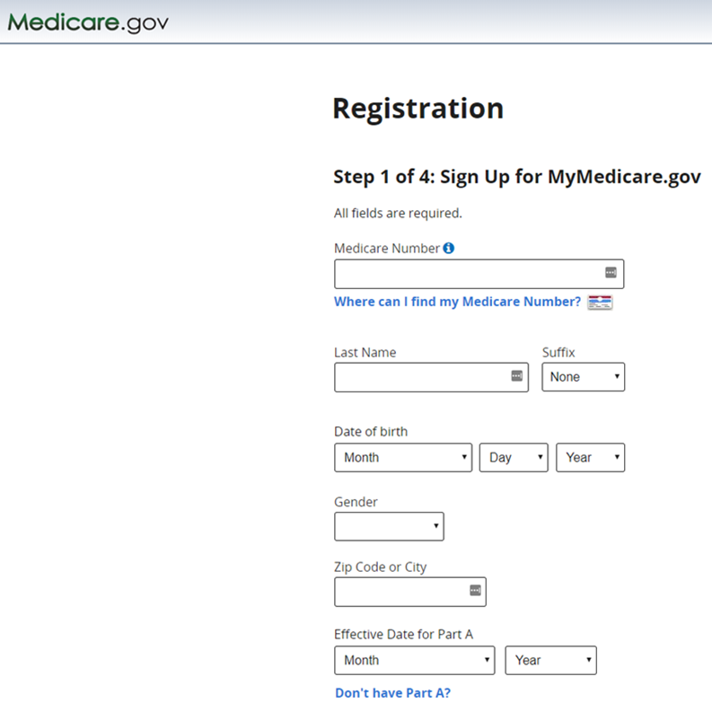
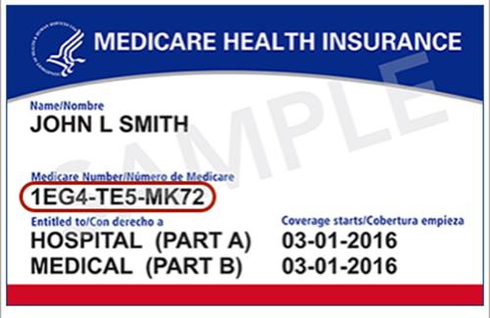
Creating a Medicare Account

Slide 20
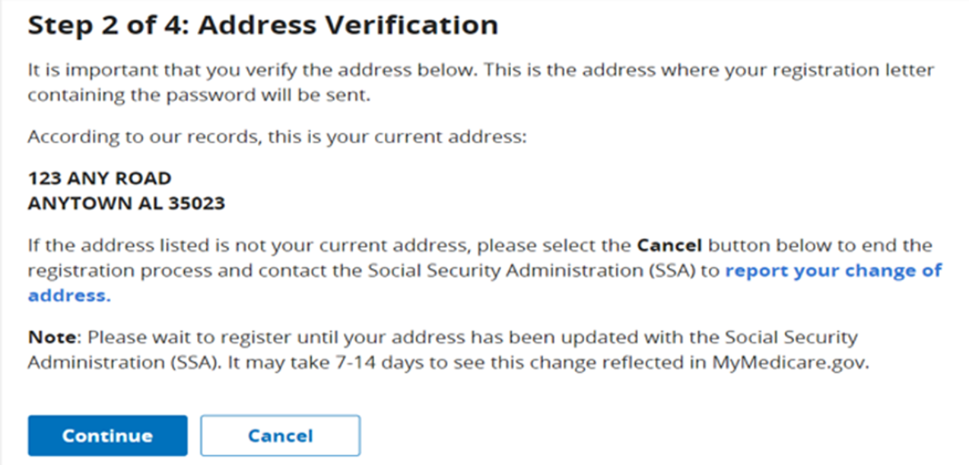
Creating a Medicare Account

Slide 21
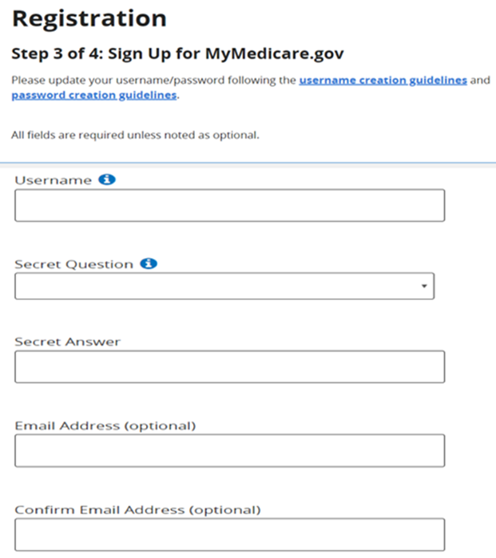
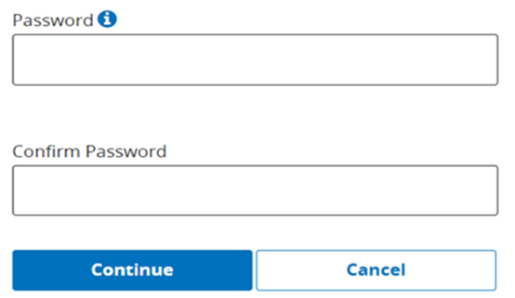
Creating a Medicare Account

Slide 22
Creating a Medicare Account

Slide 23
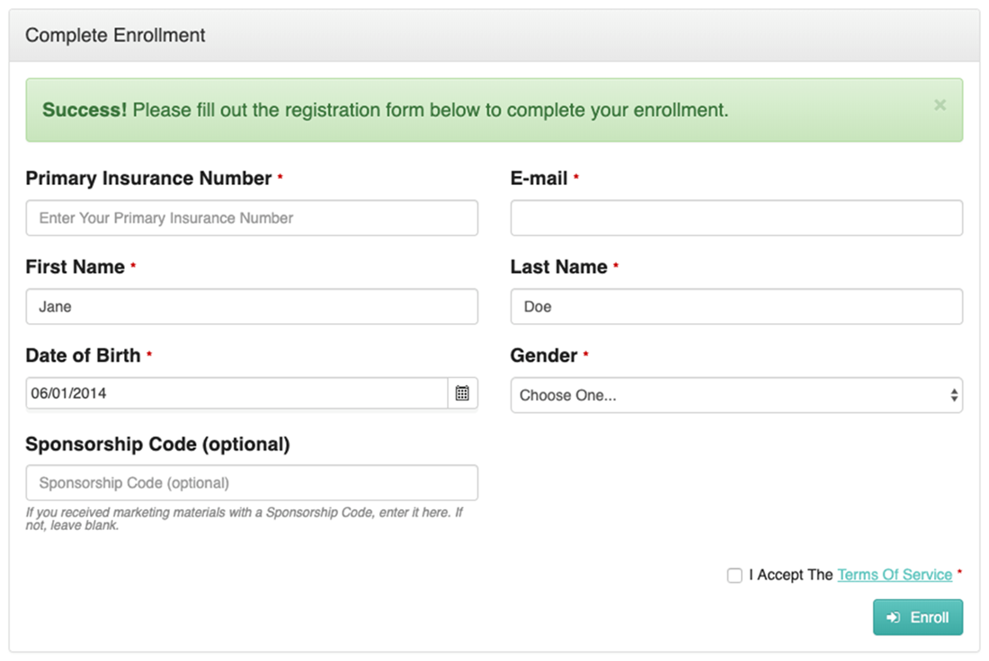
Creating a Medicare Account

Slide 24
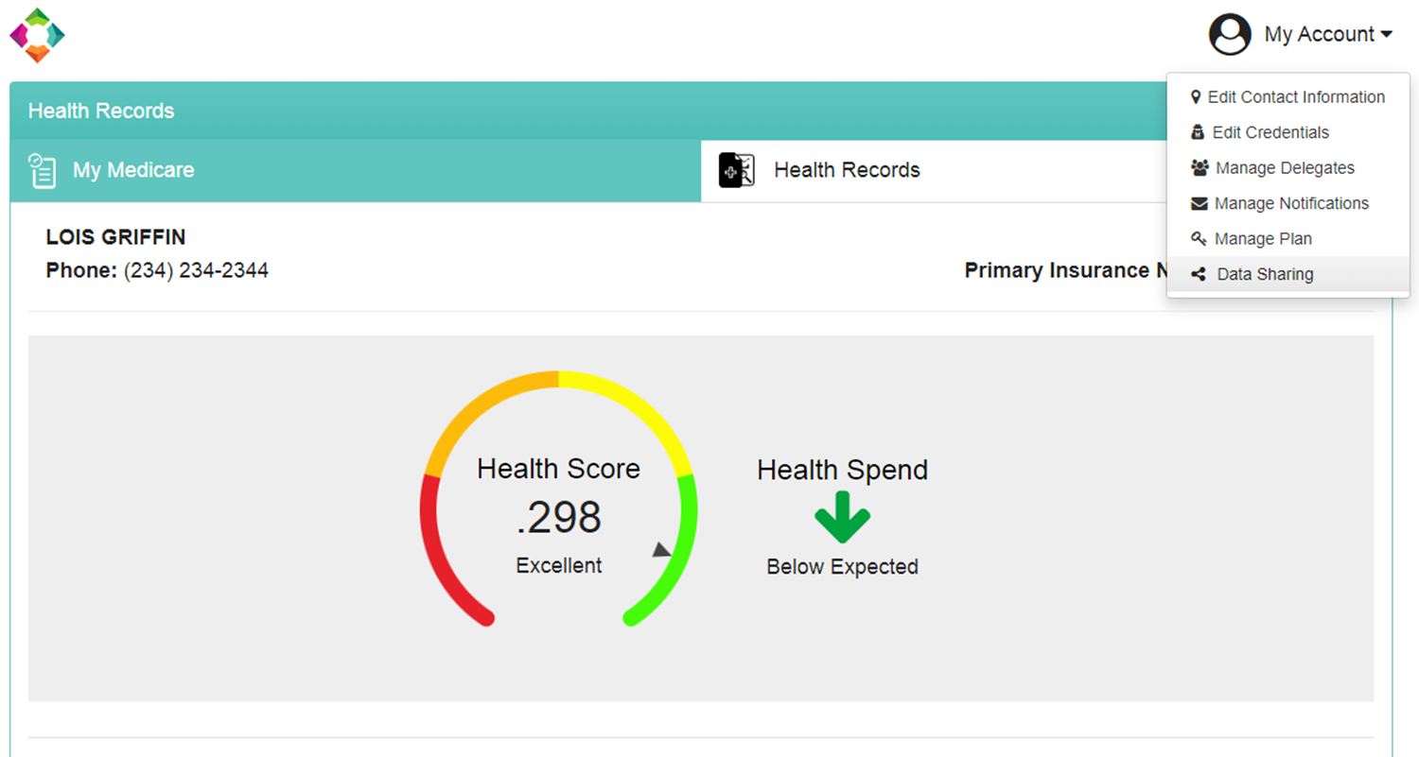
Get Your Health Record

Slide 25
Get Your Health Record

Slide 26
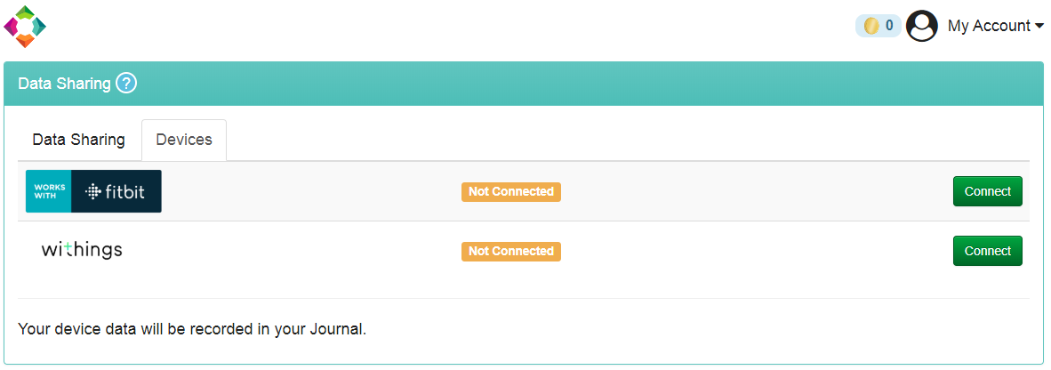
Get Your Health Record

Slide 27
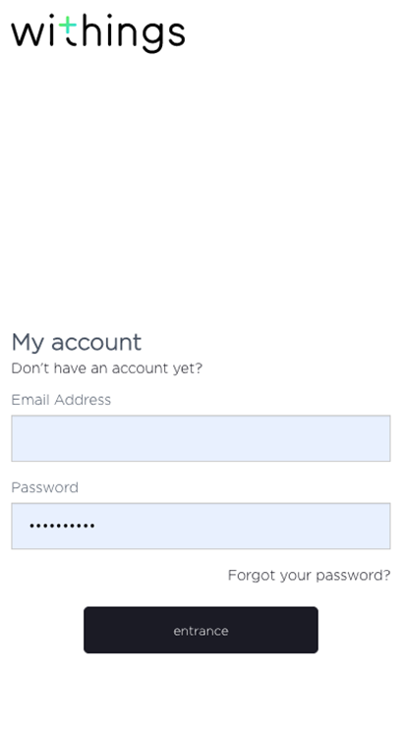
Connect WiThings Device to GYHR

Slide 28
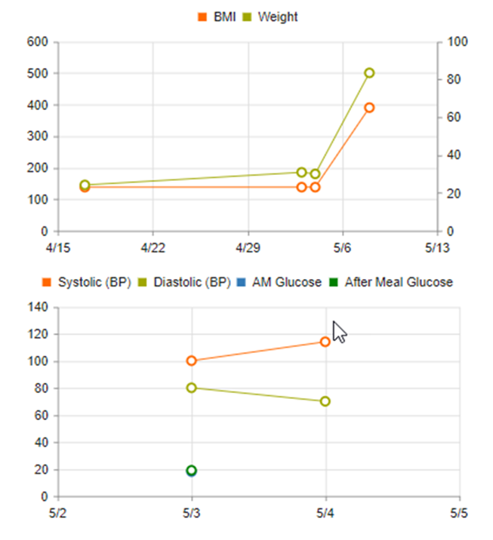
View Recordings in My Journal

Slide 29
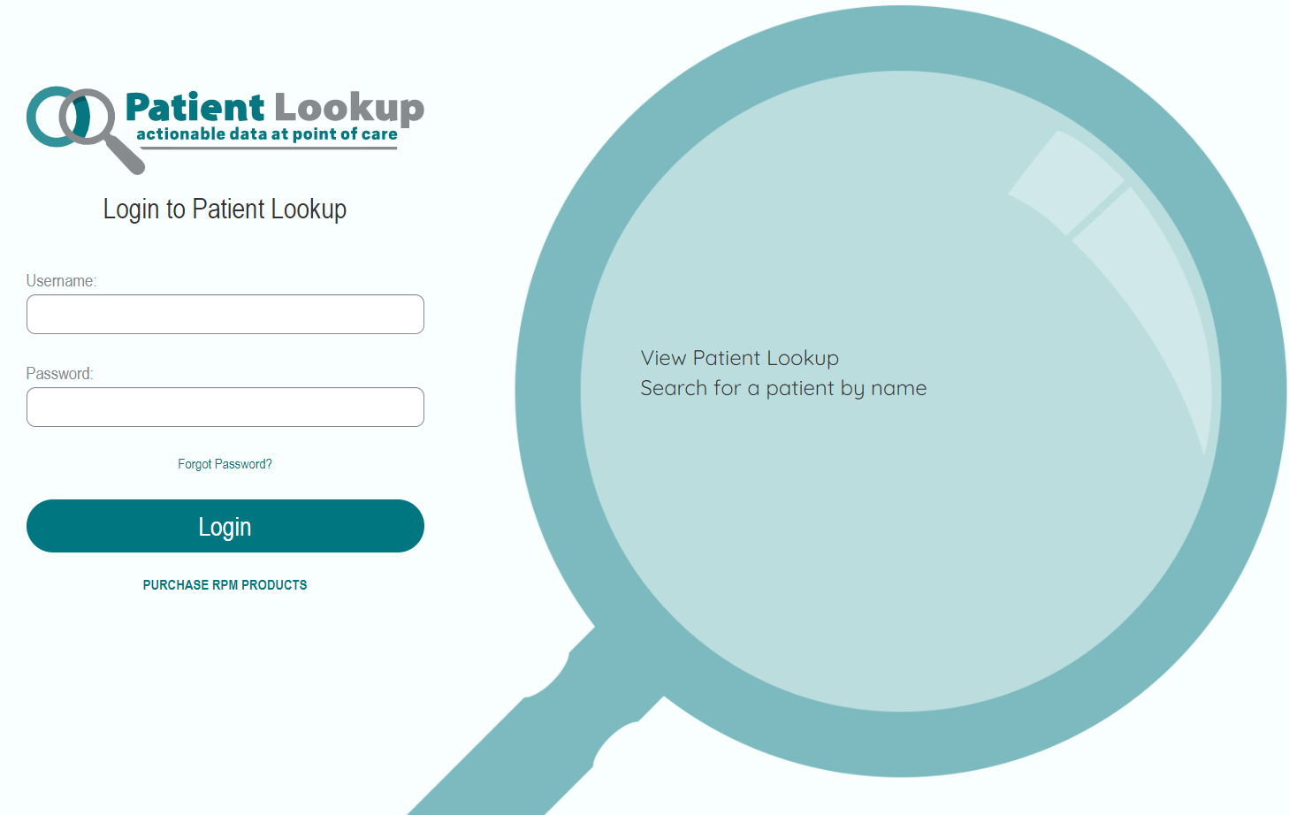
www.patientlookup.com Admin Users
4 Years of Health History with Weekly Updates
Diagnosis & Medications, Quality Care Gaps, Cost & Utilization
Patient Interactive Health History Form
Remote Patient Monitoring (RPM) Program

Slide 30
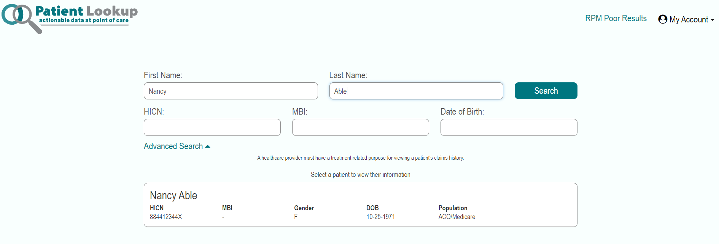
Patient Lookup

Slide 31
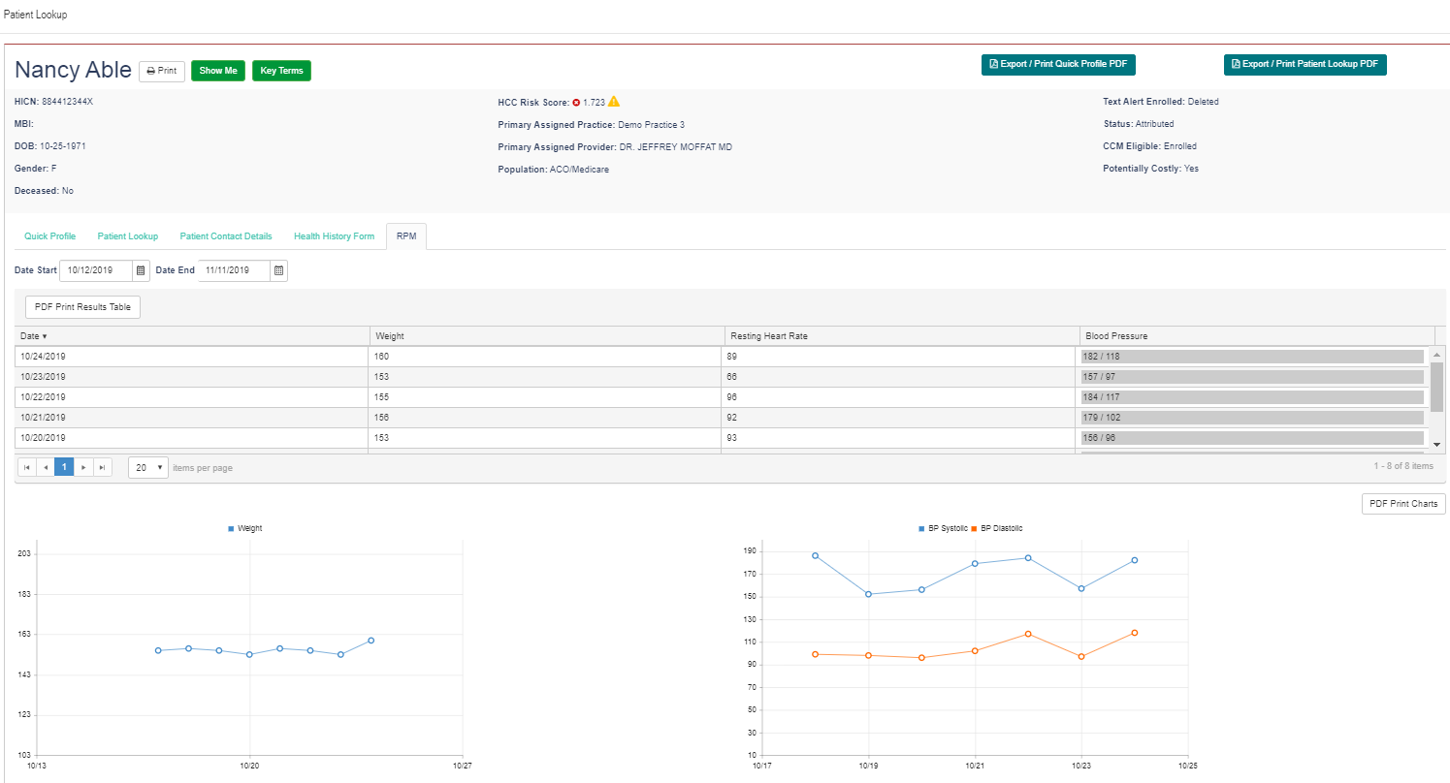
Patient Lookup

Slide 32
BPM Connect Factory Reset
On iOS & Android: 1. Go to devices and select settings 2. Select Disassociate this Product then Remove from my account
Device Factory Reset 1. Press and hold the monitor's button for 6 seconds until System is displayed on the screen 2. Release the button. This will take you to the default option “INFO”.
3. By holding the button for about 2 seconds you can switch between the options: “INFO”, “SYSTEM”,”QUIT”, “RESET”,”DEMO”.
3. Once you see “RESET” option, click the button(do not hold).
4. To confirm “RESET” selection you have to click the button 5 times, so that count down will be displayed. This will turn off the device.
4. “SETUP” will display across the screen once the reset is over – press and hold until device turns off .
Setup New Device:
1. Follow setup instructions starting from slide 14
https://support.withings.com/hc/en-us/articles/360024397874-BPM-Connect-Performing-a-factory-reset

Slide 33
Body + Weight Scale Factory Reset
On iOS & Android:
1. Go to Settings for device
2. Select Disassociate this Product then Remove from my account Device Factory Reset: 1. Hold button on the back of the scale for 8 seconds then release
2. Click button till you select Reset 3. Device will reset. You may get message go.withings.com
4. Apply weight to scale – do not set weight. Scale will then turn off
Setup New Device:
Complete app install then click next to connect app to scale.
Hold button on the back of the scale until the mobile device detects scale.
Click Next on app
Continue setup starting from slide 10.

